Slide 1

Capstone Project-Business Intelligence solution
Ben Hebbel
Colorado State University Global
MIS-480: Capstone-business analytics and Information systems
Professor: Justin Bateh
10/9/22

Slide 2
Introduction
Organization
theory
Data set
Data analysis
Benefits
Notes:
My name is Ben Hebbel, and this presentation will cover five areas of the business intelligence project for Kay Jewelers. It will first cover the organization, the company's history, and their mission. Then it will go over the theory that will be analyzed. Next, it will go over the data set and how it is appropriate to test the problem or theory. Then it will go over the analysis of the solution and explain the results. Lastly, it will cover the benefits that a business intelligence solution can provide.

Slide 3
Us Organization
Kay Jewelers
History of Kay Jewelers
Mission
Notes:
The organization that was chosen for this project is Kay Jewelers. Kay Jewelers first opened in Reading, Pennsylvania, in 1916. When the store first opened, it sold eyeglasses, silverware, appliances, and razors alongside jewelry (Kay Jewelers, 2022). Kay Jewelers would later evolve into selling only jewelry; now, they are part of Signet Jewelers. Kay Jewelers mission is to help a customer celebrate life and express love (Kay Jewelers, 2022). Kay accomplishes this by providing customers high quality and competitively priced diamonds.

Slide 4
theory
Quality Diamonds for less
Determine price of a Diamond
Notes:
The theory that will be tested for Kay Jewelers is can they purchase high-quality diamonds for less. There are multiple qualities that are graded to determine the price of the diamond. These qualities include cut, carat, color, and clarity. The industry standard diamond grading system uses the GIA International Diamond Grading System (ForgeJewleryWorks, 2022). The color can determine the price of a diamond; the color is graded on a scale ranging from D-Z, with D being colorless and Z being Light. Diamonds are graded by being compared to a diamond of color in a controlled environment (ForgeJewleryWorks, 2022). This grading system is used to determine the other qualities except for the cut. The cut of a diamond uses points; for example, the American dollar is broken down into pennies. If a diamond is 500 points, then that diamond is a 5.0 carat diamond.

Slide 5
Data Set
Industry standard grading
Price
Large Data set
Notes:
The data set that was chosen for this project is called diamonds. This data set has all the qualities that help determine the price of the diamond and some additional qualities that measure the diamond's depth and size. The data set has a price variable that can be used to help determine the price of a diamond using cut, clarity, color, and carat. The data set is substantial, as it has over 54,000 data points. This data set will help Kay Jewelers determine the best diamonds that are inexpensive.

Slide 6
Data Storage
Excel CSV file
One Drive
Class folder
Notes:
The data is stored in a CSV file because it is easier to read into the environment of Python or R-studio. The CSV file will be stored in a class folder on OneDrive. OneDrive is Microsoft's personal cloud service that connects you to all your files (Microsoft, 2022). Since the data is stored on the cloud, it provides easy access to the data set while still being secure. Since the file is in a class folder, it allows me to avoid setting up a working directory to read the data set into the BI tool environment.

Slide 7
BI Tools
Python
R-studio
Open source
Data Analysis
Notes:
The tools that are going to be used are Python and R-studio. Python is an object-oriented high-level programming language with dynamic semantics (Python, 2022). Python has a number of packages that allow the user to transform and analyze data. Python will be used to analyze the diamonds data set, but if things do not work out, then R-studio will be used to analyze the data set. R-studio utilized the R language that utilizes packages which help with machine learning. Both languages are open source and are free to download. Both tools are great for analyzing data and building reports.

Slide 8
Data Visualizations
Scatter plot
Histogram
Box plot
Notes:
The data visualizations that are going to be used are scatter plots, histograms, and boxplots. A histogram is a type of bar chart that distributes the data into different bins that helps the analysis of the data (Tableau, 2022). The histograms can also be filled with a color map to help identify and compare another value, such as cut. Boxplots show a selection of ranges that are set across a set measure (Tableau, 2022). Boxplots can also be used to see any outliers in the data. Scatter plots are used to observe the relationship between variables. This can be used to group variables and create linear regression models.

Slide 9
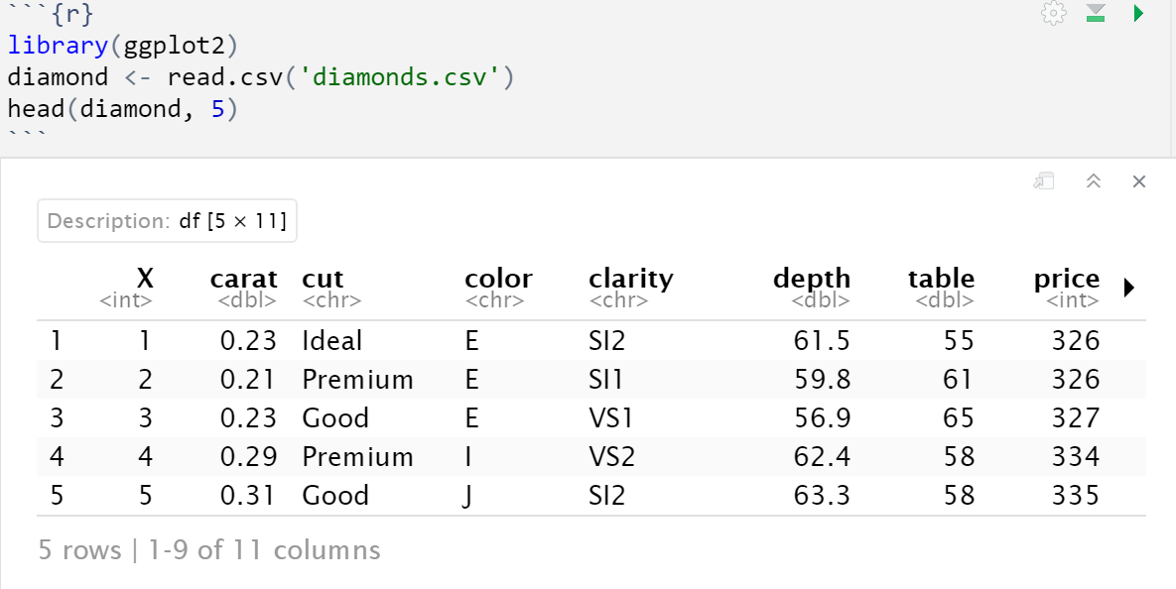
Reading in Data
Data frame
Reading in the csv file
Display Data
Notes:
This block of code shows the data set being read into the R-studio environment. The data set is put into a data frame called diamond. The head() function is used to display the first five values in the diamonds data set. The library ggplot2 is also loaded into the environment to help create the data visualizations.

Slide 10
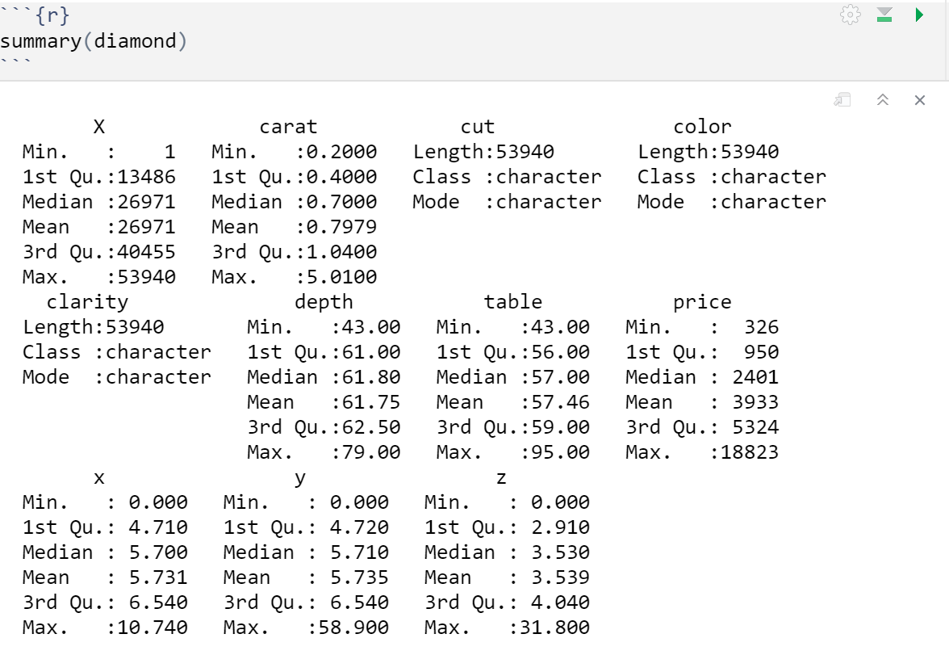
Data Summary
Better understanding
Five number summary
Variable description
Notes:
This block of code calculates the summary statistics of the data set. The summary() function is used to complete the calculation. This function is used to get a better understanding of the data set. It gives a five number summary showing the mean, median, and maximum values (PluralSight, 2019). It calculates the five number summary for numerical values while it gives the class and mode of non-numerical values.

Slide 11
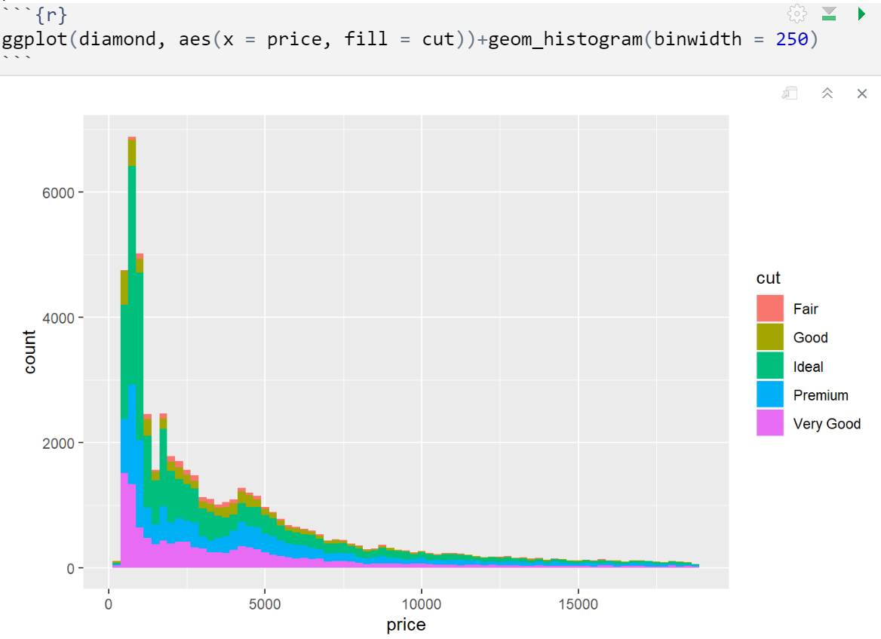
Price to cut
Distribution of diamonds
Bulk of data is $5,000 and under
Notes:
The code block below shows the distribution of the variable price, and it shows the cut of the diamond. As you can see, most of the diamonds are distributed on the left-hand side of the histogram. The price of a diamond can range from under $1,000 to approximately $20,000. It does show that there are diamonds that do have a "very good" cut rating under $5,000. This graph shows that Kay Jewelers can get diamonds that have a good cut rating for a low price.

Slide 12
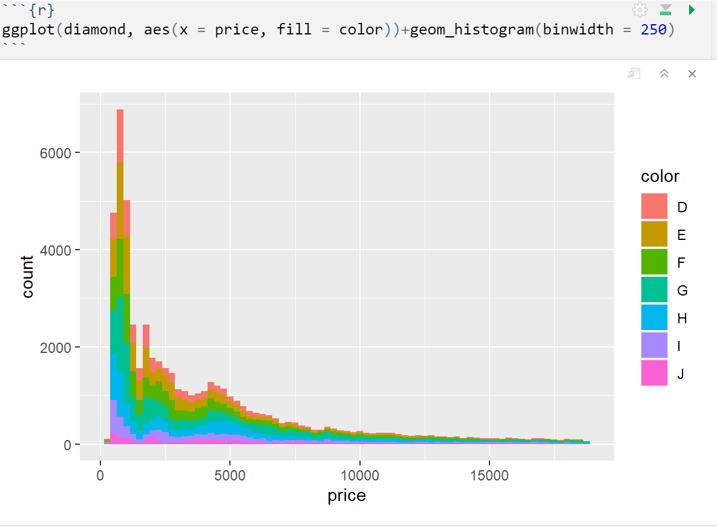
Price to Color
Distribution of price to color
MOST Diamonds have color grade of D
Few diamonds with a color grade of J
Notes:
This block of code shows a histogram comparing the price to the color of the diamonds in the data set. The color map shows that only a few diamonds have a color grade of J. It also shows that most of the diamonds have a color grade of D, which is the best, and are under $5,000. This indicates that Kay Jewelers can purchase diamonds for a low price that have the best color grade.

Slide 13
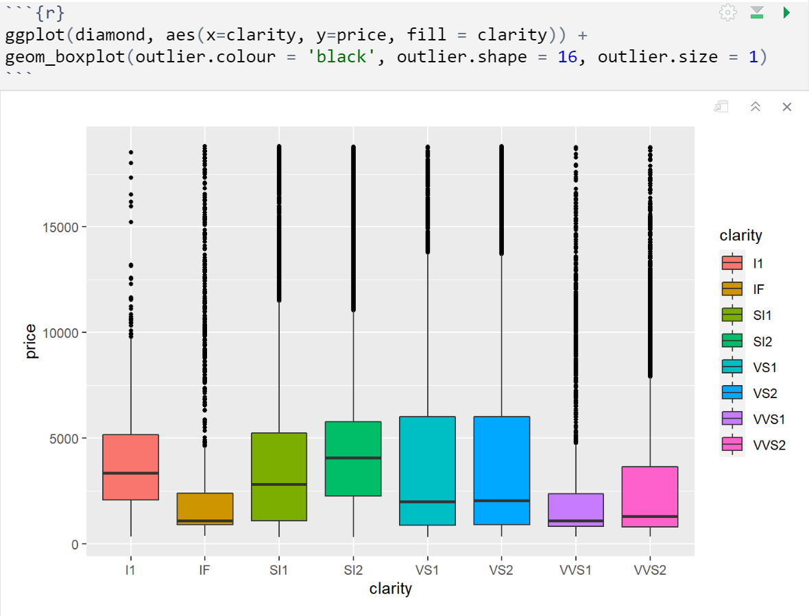
Clarity to Price
Compares diamond clarity to price
Median of under $5,000
Outliers
Notes:
This block of code shows a box plot comparing the clarity of a diamond to the price. The display shows that there are many outliers in the data. The box plot shows the median, upper and lower quartile, and whiskers; anything outside the box is considered extreme (DataCamp, 2020). The outliers in the plot show that each clarity category has expensive diamonds, but all the boxes have a median below $5,000.

Slide 14
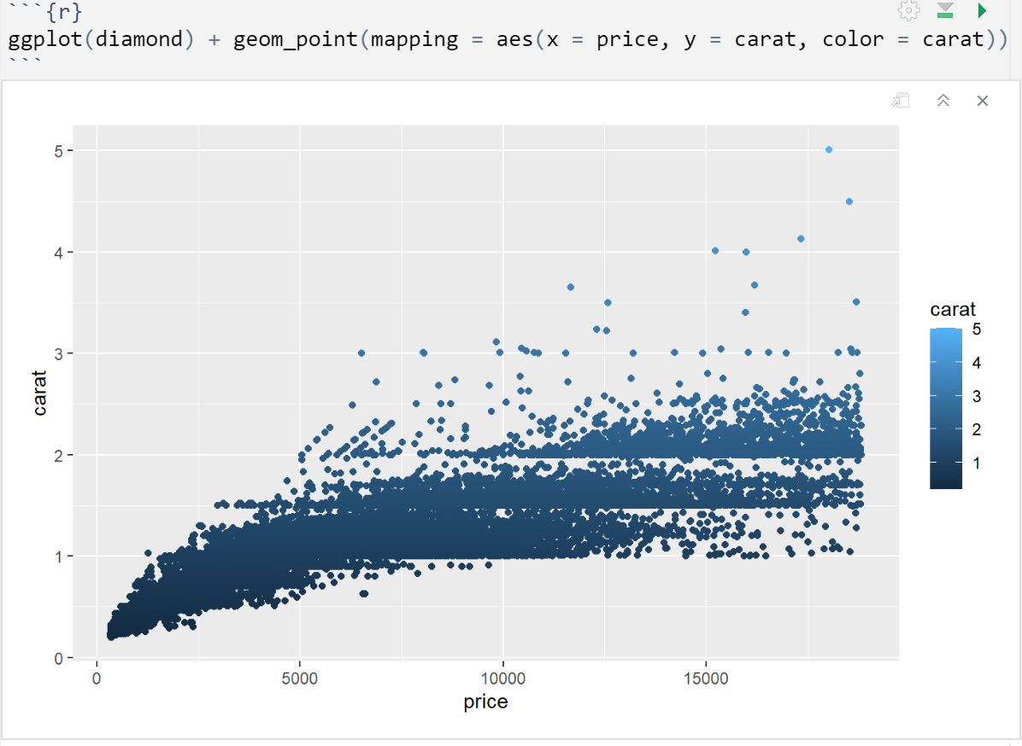
Price vs carat
tremendous impact on price
Majority are below three carats
Notes:
The scatter plot compares the diamonds' price and carat in the data set. This graph shows that the carat highly affects the price of a diamond. The majority of diamonds in the data set are at or below three carats. The graph shows that diamonds one carat and above have a price of around $3,000 to approximately $20,000. Diamonds that are above three carats are going to be expensive.

Slide 15
BI Benefits
Increase Efficiency
Data Driven Decisions
Competitive advantage
Notes:
Business intelligence solutions can and will provide insights into the organization. It gives leaders a holistic view of their operations and benchmark results over the larger organization (Tableau, 2022). With a holistic perspective, leaders can identify opportunities. The next benefit that business intelligence provides is data-driven decisions. Accurate data and faster reporting capabilities provide an organization with better business decisions (Tableau, 2022). Lastly, it can give an organization a competitive advantage. Businesses can be more competitive when they understand the market and how they perform in it (Tableau, 2022). Knowing where the market is and how you perform enables companies to adjust accordingly, increasing their performance as a business and in the market.

Slide 16
Conclusion
Identify opportunities
Valuable insight
Remain competitive
Notes:
A well planned business intelligence solution can give an organization valuable insight to identify areas of opportunity, stay competitive in the market, and increase customer experience and satisfaction. The theory that was analyzed for Kay Jewelers was, can they purchase quality diamonds for less? The analysis answered that theory, and yes, Kay Jewelers can purchase quality diamonds for less if the diamond has a carat of three or less. The carat of a diamond highly affects the price of the diamond. Kay Jewelers can purchase quality diamonds for less and still accomplish its mission to give everyone the gift of love. This shows how important it is to utilize BI tools to help businesses grow in their industry. Using the diamond data set, Kay Jewelers could lower their costs, giving them a competitive advantage in the market.

Slide 17
References
Kay Jewelers. (2022). Why Kay?.
https://www.kay.com/why-kay?icid=FOOTER:WHYKAY
FordgeJeweleryWorks. (2022). How Do I Determine A Diamonds Value?.
https://www.forgejewelryworks.com/determine-diamonds-value/
Python. (2022). What is Python? Executive Summary.
https://www.python.org/doc/essays/blurb/
Tableau. (2022). What is Data Visualizations? Definition, examples, and Learning Resources.
https://www.tableau.com/learn/articles/data-visualization
Microsoft. (2022). What is OneDrive for Work or School?.
https://support.microsoft.com/en-us/office/what-is-onedrive-for-work-or-school-187f90af-056f-47c0-9656-cc0ddca7fdc2
PluralSight. (2019). Interpreting Data Using Descriptive Statistics With R.
https://www.pluralsight.com/guides/interpreting-data-using-descriptive-statistics-r
Tableau. (2022). The top 7 benefits of business intelligence (BI).
https://www.tableau.com/learn/articles/business-intelligence/enterprise-business-intelligence/benefits
Data Camp. (2020). Box Plot in R Tutorial.
https://www.datacamp.com/tutorial/boxplot-in-r

